Slide 1
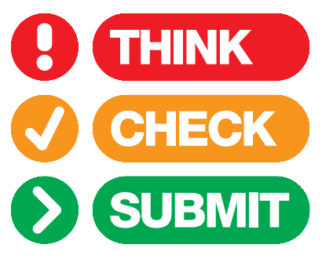
Lars Bjørnshauge
Managing Director, DOAJ

Slide 2
Launched this morning at the Frankfurt Book Fair!
Lars Bjørnshauge
Managing Director, DOAJ

Slide 3
i
What?
Think. Check. Submit. campaign
Help researchers identify trusted journals
A simple checklist to assess credentials
Help ensure a corpus of quality literature

Slide 4
i
Why?
More research is being published worldwide
New journals launched each week
Stories of malpractice & deception on the rise
Can be a challenge to find up-to-date guidance

Slide 5
i
Implications
Journal has low or no profile among peers
  > Few or no citations
Paper not indexed or archived
  > Difficult or impossible for peers to find
Poor publishing experience
  > Work not adequately reviewed or edited
Damaged reputation

Slide 6

Are you submitting to a trusted journal?
Does the journal provide services that promotes your work efficiently?

Slide 7

Do you or your colleagues know the journal?
Can you identify, and contact, the publisher?
Do you recognize the editorial board?
Are any publication charges clearly stated?
Is the journal clear about the type of peer review it uses?

Slide 8

If you can answer ‘yes’ to all or most of the check list questions
Only then should you submit your article

Slide 9
i
Interested?
w. thinkchecksubmit.org
e. feedback@thinkchecksubmit.org
t. #thinkchecksubmit

Slide 10
i
Who?
Publisher organizations:
ALPSP, OASPA & STM
Other organizations:
INASP, ISSN, LIBER, UKSG & DOAJ
Publishers to be listed when we go live!

Slide 11
i
Get involved
Researchers: use the list, tell us what you think
Librarians: add check list to faculty resources
Publishers: add to author guidelines and share
All: visit thinkchecksubmit.org, submit your FAQs via #thinkchecksubmit

