Slide 1

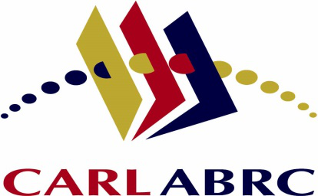

Librarians’ Competencies in Support of E-Research and Scholarly Communication
Iryna Kuchma, Birgit Schmidt, Kathleen Shearer,
Pascal Calarco, Rob Grim, Alicia López Medina, Susan Reilly, Judy Ruttenberg, Dominic Tate
October 14, 2014
Bibliotheca academica 2014

Slide 2
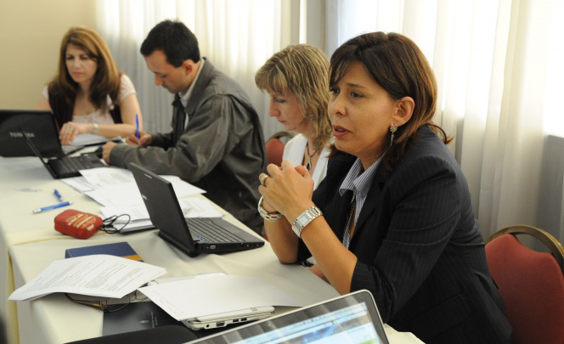
Drivers for the Task Force (TF)
Carmen-Gloria Labbe, co-Chair of the COAR Board: Discussion around COAR training in Latin America for repository managers, evolved into competencies, included in COAR Strategic Plan
LIBER, ARL, CARL joined

Slide 3
Charge & scope of TF work
Outline the competencies needed by librarians in an evolving environment
Identify the avenues of service for libraries within the context of e-research, repository management, & scholarly communication
Map the services & roles to the competencies required by librarians and library professionals

Slide 4
Charge & scope of TF work (2)
Note of the array of organizational models evolving to support new services
Produce a toolkit that will help to build capacity in libraries for supporting new roles

Slide 5
Activities over the last year
Defining collaboration tools & processes
Literature review
Identified E-Research specialization areas
Gathered job descriptions from web searches
Wiki/Dropbox/Google Drive for community communication & feedback
What ‘the toolkit’ might look like – ideas discussed

Slide 6
Challenges
“E-Research” not used globally; jargon
Relationships & overlap between specializations, competencies, skills
Terminology/nomenclature imprecise, variable
Competencies: hard & soft skills
Qualifications for competencies based in practice, less in academic programs, although this is evolving

Slide 7
Community feedback
Task Force relies on feedback from these communities of practice around E-Research
Presentations at: CNI (March & April 2014; St. Louis, MO); COAR General Assembly (May 2014, Athens); OR 2014 (June 2014, Helsinki), LIBER (July 2014, Riga)
Ideas for venues to connect for other service areas welcome
Consulting group: advise & provide feedback

Slide 8
Outcomes – Service Areas
Scholarly Communication & OA
Research Data Management (RDM):
Definition
Roles involved
Core competencies
List of job titles
Related service areas
Selected literature

Slide 9
Competency areas: Scholarly Communication & OA
Roles involved:
Scholarly publishing services
Copyright & OA advocacy & outreach
Scholarly resource assessment

Slide 10
Competency areas: Scholarly Communication & OA (2)
Core competencies: Scholarly publishing services
OA publishing models
Infrastructure (OJS, OMP, repositories)
Standards: DOI, ISSN, ISBN, persistent URL and citation options, such as OpenURL and CNRI Handle

Slide 11
Competency areas: Scholarly Communication & OA (3)
Core competencies: Scholarly publishing services (2)
Funder OA mandates and requirements
Data formats, database design, data management, data manipulation tools
Awareness of data curation and preservation options

Slide 12
Competency areas: Scholarly Communication & OA (4)
Core competencies: Copyright and OA advocacy and outreach
OA policy and advocacy
Support and training

Slide 13
Competency areas: Scholarly Communication & OA (5)
Support and training:
Raise awareness for the need and options of OA, including practical questions such as financing
Advise faculty and graduate students on alternatives to signing away copyright to their original scholarly works

Slide 14
Competency areas: Scholarly Communication & OA (6)
Support and training (2):
Promote data sharing and reuse, explain data citation
Copyright and intellectual property licensing issues relating to scholarship and commercial and non-commercial publishing; Creative Commons and other OA license models

Slide 15
Competency areas: Scholarly Communication & OA (7)
Support and training (3):
Advisory skills, collaboration skills, service marketing, project management, etc.
Management of digital collections, metadata standards, discovery tools
Traditional scholarly publishing economics and open access benefits and requirements

Slide 16
Competency areas: Scholarly Communication & OA (8)
Core competencies: Scholarly resource assessment
Bibliometrics and altmetrics theory & practice
Faculty promotion & tenure policies & procedures
Institutional assessment/planning interests in scholarly output

Slide 17
Competency areas: Scholarly Communication & OA (9)
Related service areas & roles: Research data management, collection development, advisory services (copyright, policies, etc.), information literacy
To work with: Digital Repository Librarian, Subject Librarian, Digital Initiatives Librarian, Digital Humanities Librarian

Slide 18
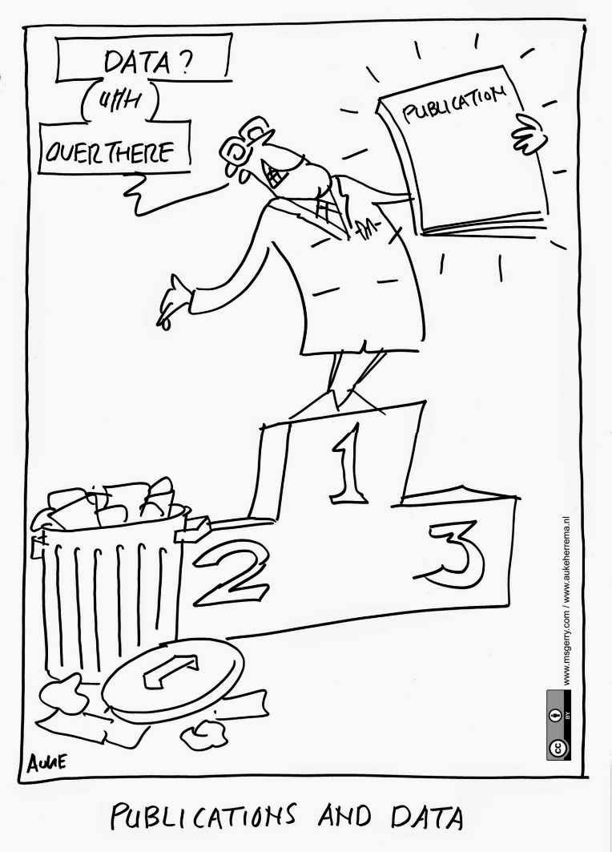
Image courtesy of http://aukeherrema.nl/ CC-BY

Slide 19
Competency areas: RDM
Roles involved:
Providing access to data
Advocacy & support for managing data
Managing data collections

Slide 20
Competency areas: RDM (2)
Core competencies:
Some level of subject knowledge is required. In particular librarians need to have an understanding of the disciplinary landscape, norms, and standards.

Slide 21
Competency areas: RDM (3)
Core competencies: Providing access to data
Data centres, repositories & collections
The way data are organized & structured within these collections
Data licensing & IP policies and principles
Data manipulation/analysis techniques & tools

Slide 22
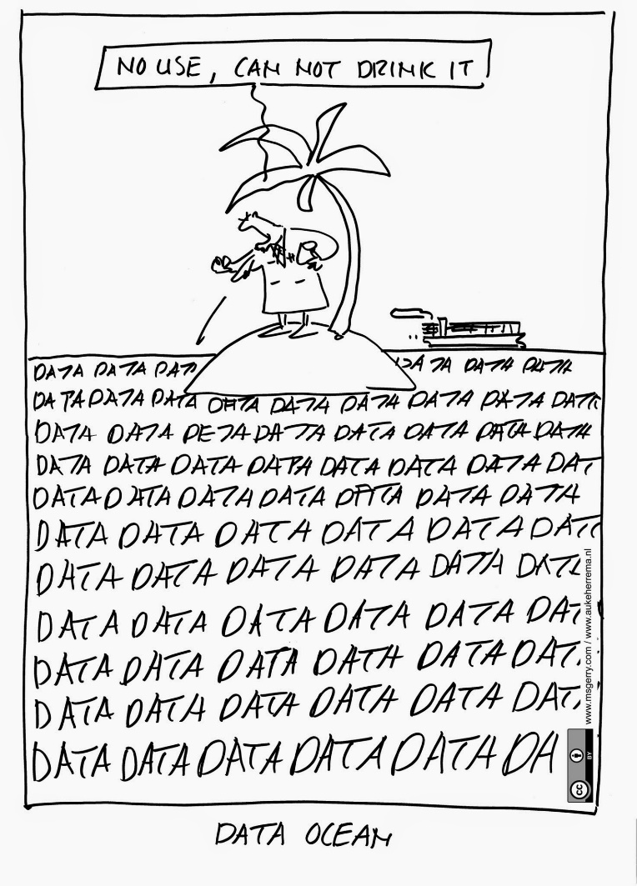
Image courtesy of http://aukeherrema.nl/ CC-BY

Slide 23
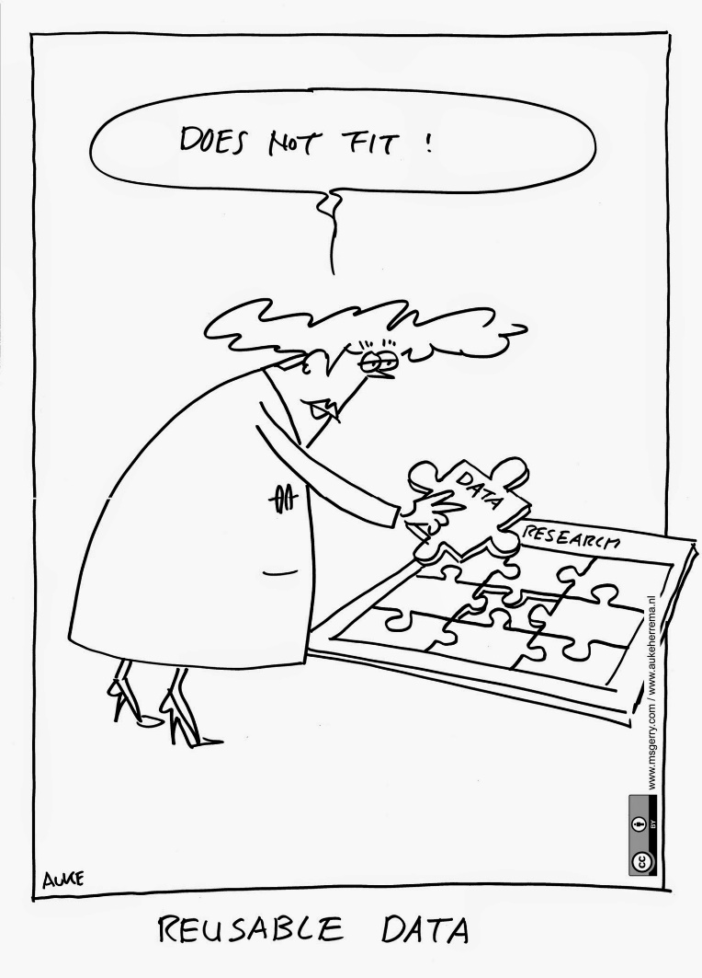
Image courtesy of http://aukeherrema.nl/ CC-BY

Slide 24
Competency areas: RDM (4)
Core competencies: Advocacy & support for managing data
Funders’ policies & requirements
Data management plans
Articulate benefits of data sharing & re-use
Research practices & workflows
Disciplinary norms & standards

Slide 25
Competency areas: RDM (5)
Core competencies: Advocacy & support for managing data (2)
Data structures, types & formats
Best practices for managing data, standards, metadata & vocabularies
Data publication requirements of specific journals

Slide 26
Competency areas: RDM (6)
Core competencies: Advocacy & support for managing data (3)
Data sharing options, open access, IPR, licenses
Data audit and assessment tools.

Slide 27
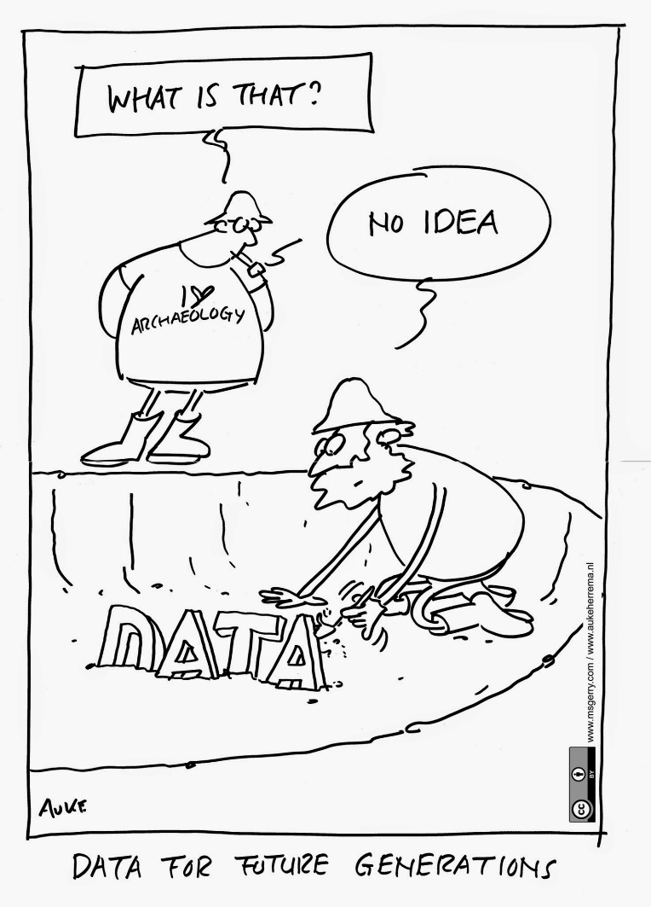
Image courtesy of http://aukeherrema.nl/ CC-BY.

Slide 28
Competency areas: RDM (7)
Core competencies: Managing data collections
Selection & appraisal techniques for datasets
Metadata standards & schemas, data formats, domain ontologies, identifiers, data citation, data licensing
Discovery tools

Slide 29
Competency areas: RDM (8)
Core competencies: Managing data collections (2)
Database design types & structures
Data linking & data integration techniques
Data storage infrastructures
Digital preservation metadata
Forensic procedures in digital curation

Slide 30
Competency areas: RDM (9)
Related service areas & roles: OA & institutional repositories, collection development, advisory services (copyright, policies, etc.), information literacy, digital curation, digital preservation, digital collections
To work with: Data Creator, Data Scientist, Research Coordinator/Manager, Data Curator, Digital Preservation Librarian, Repository Manager, Subject Librarian

Slide 31
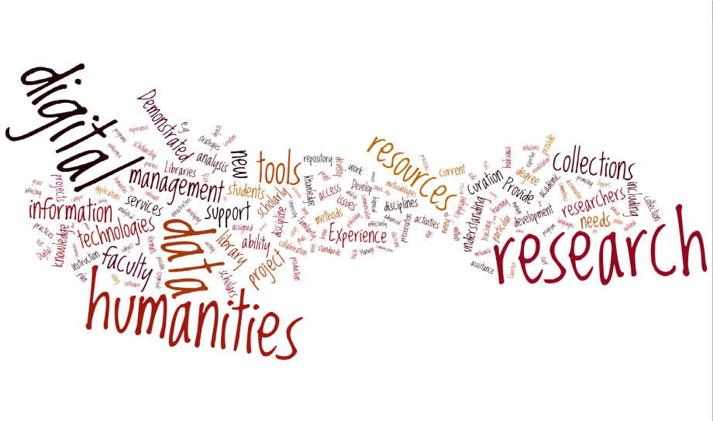
Activity Report
Working Group 1:
Repository Content
Silvia Nakano
May 21, 2014
COAR General Assembly 2014,
Athens, Greece

Slide 32
Outcomes – Service Areas
Digital Humanities (DH):
Framework
Roles involved
Services/Tasks/Functions/Responsibilities
Competencies/Skills/Expertise
Related service areas & roles
Literature

Slide 33
Outcomes – Service Areas
Discussions with DH practitioners
Maryland Institute for Technology in the Humanities
The Ohio State University
University of Colorado Libraries DH Task Force
ACRL Digital Humanities Interest Group
University of Florida DH Libraries Group
University of Virginia Scholars Lab
Gottingen Centre for Digital Humanities
DARIAH-EU...

Slide 34
Competency areas: DH
Services/Tasks/Functions/Responsibilities
Scholarly communication & publishing
Technical services
Digital Humanities Research and Consulting
Teaching/training
Space/Collaboratories

Slide 35
Competency areas: DH (2)
Competencies/Skills/Expertise
Subject/domain: Academic subject expertise, Librarianship & Scholarly Communication, Data curation & management

Slide 36
Competency areas: DH (3)
Competencies/Skills/Expertise (2)
Technical: Data visualization, Text-mining, GIS, Statistical analysis tools, Designing & programming relational databases, Server-side web development, metadata standards & schema, Text markup & encoding, Software evaluation & integration, Software development

Slide 37
Competency areas: DH (4)
Competencies/Skills/Expertise (3)
Technical: Open source systems administration, Current web technologies, Network analysis & graph theory, Topic modeling, current software commonly used in digital humanities projects (e.g. Zotero, Mendeley, Omeka, etc.), knowledge on Semantic web technologies, Linked data

Slide 38
Competency areas: DH (5)
Competencies/Skills/Expertise (4)
Project Management/Program Development
Partnerships/Collaboration
Teaching/Training: Ability to educate library staff on digital arts & humanities topics

Slide 39
Competency areas: DH (6)
Related service areas & roles: Repository Manager, Data Manager & Scholarly Communication Librarian
To work with: Digital Repository Librarian, Subject Librarian, Digital Initiatives Librarian, Digital Humanities Librarian

Slide 40
Work ahead
Reviewing draft profiles & engaging in describing other service areas:
Digital preservation
Digital Curation
Metadata
Research Support
Instructional Services
Repository Management
Digital Initiatives
Technology Services

Slide 41
Work ahead (2)
Clustering competencies/specializations
Identifying areas of overlap
Probably aggregate areas that are very close in competencies/roles
Both technical “hard” skills & communication/organization “soft” skills
An imperfect art & each service area continues to evolve

Slide 42
Work ahead (3)
Developing an online toolkit that will allow library managers
to identify skill gaps in their institution;
form the basis of job descriptions/announcements;
enable professionals to carry out self-assessments;
act as a foundation for the development of training programs for librarians/library professionals.

Slide 43
Work ahead (4)
In addition, the toolkit will provide an outline of new organizational models for libraries.

Slide 44
What might the toolkit look like?
Web-based
An aggregation of documents and web resources?
A guide for developing new positions for specific needs?
Audience: administrators, practitioners, others

Slide 45
Feedback & questions
Iryna Kuchma, iryna.kuchma@eifl.net
https://www.coar-repositories.org/activities/support-and-training/task-force-competencies/

Slide 46
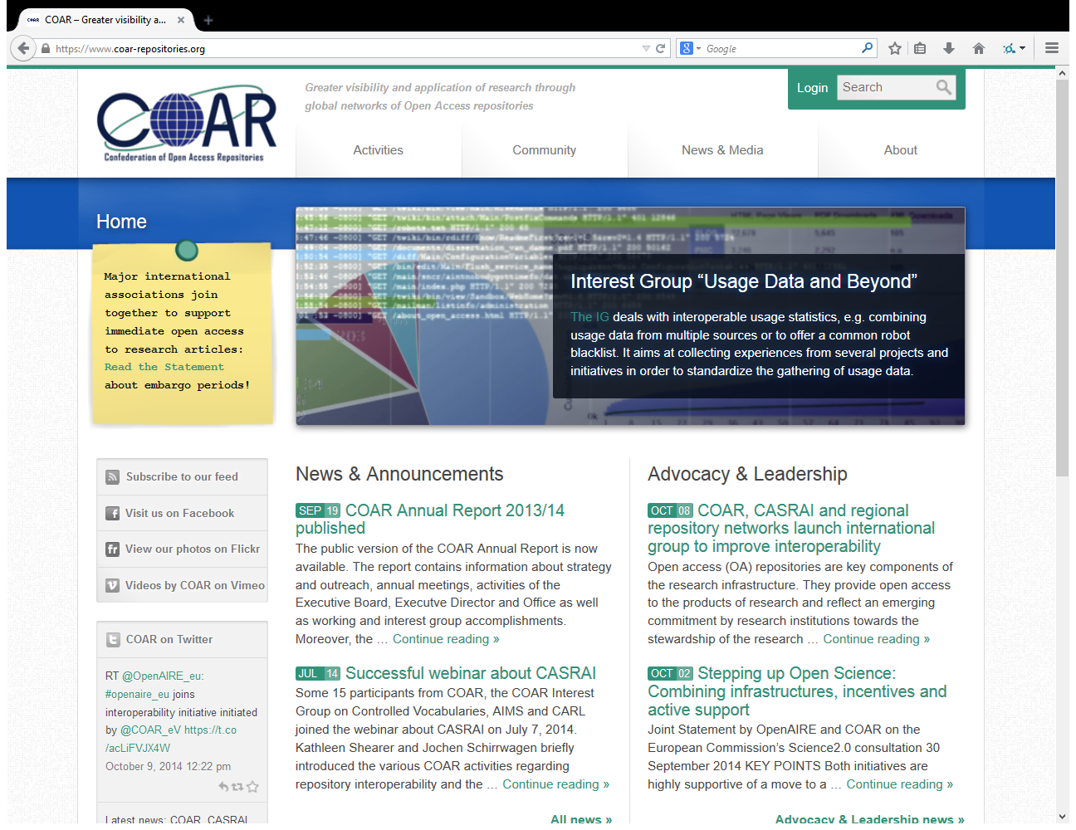
https://www.coar-repositories.org/

Slide 47
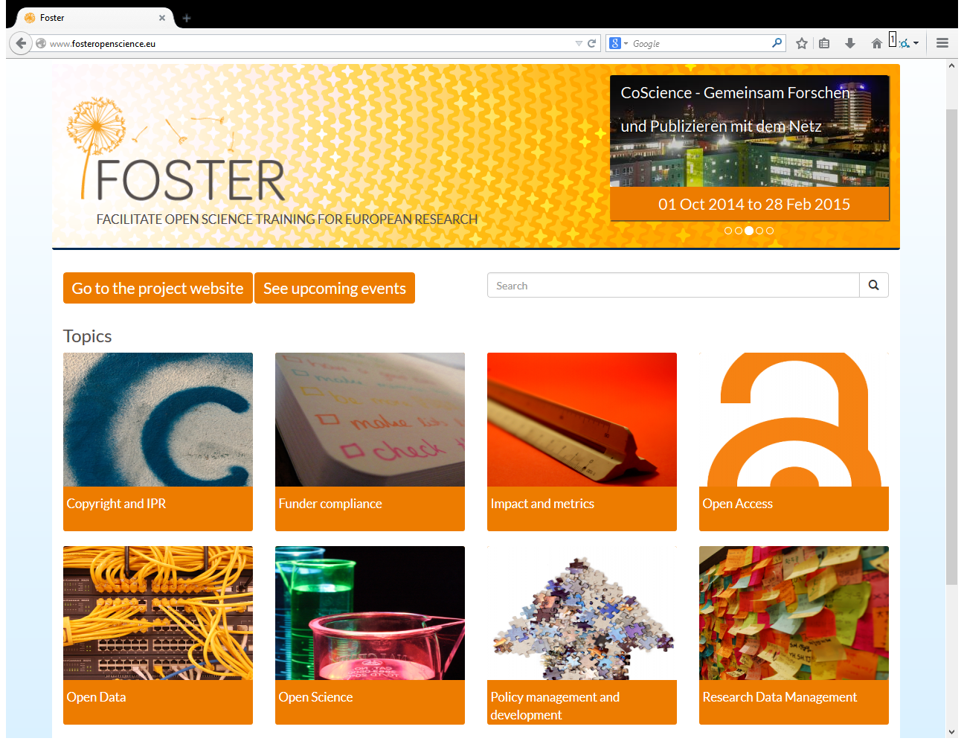
http://www.fosteropenscience.eu/

Slide 48
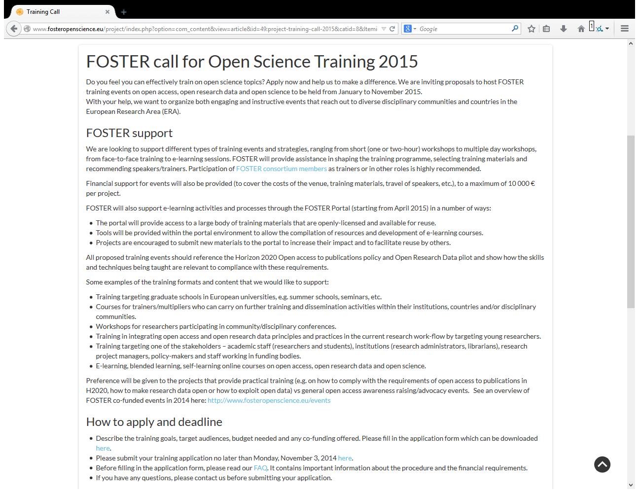
http://www.fosteropenscience.eu/

Slide 49
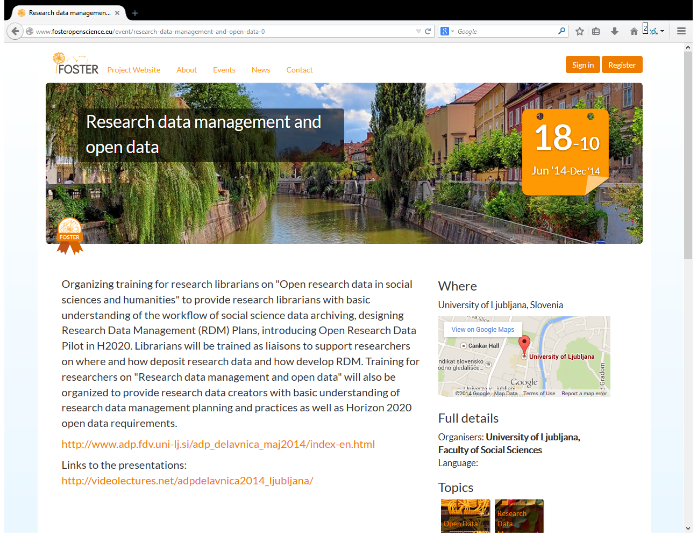
http://www.fosteropenscience.eu/

Slide 50
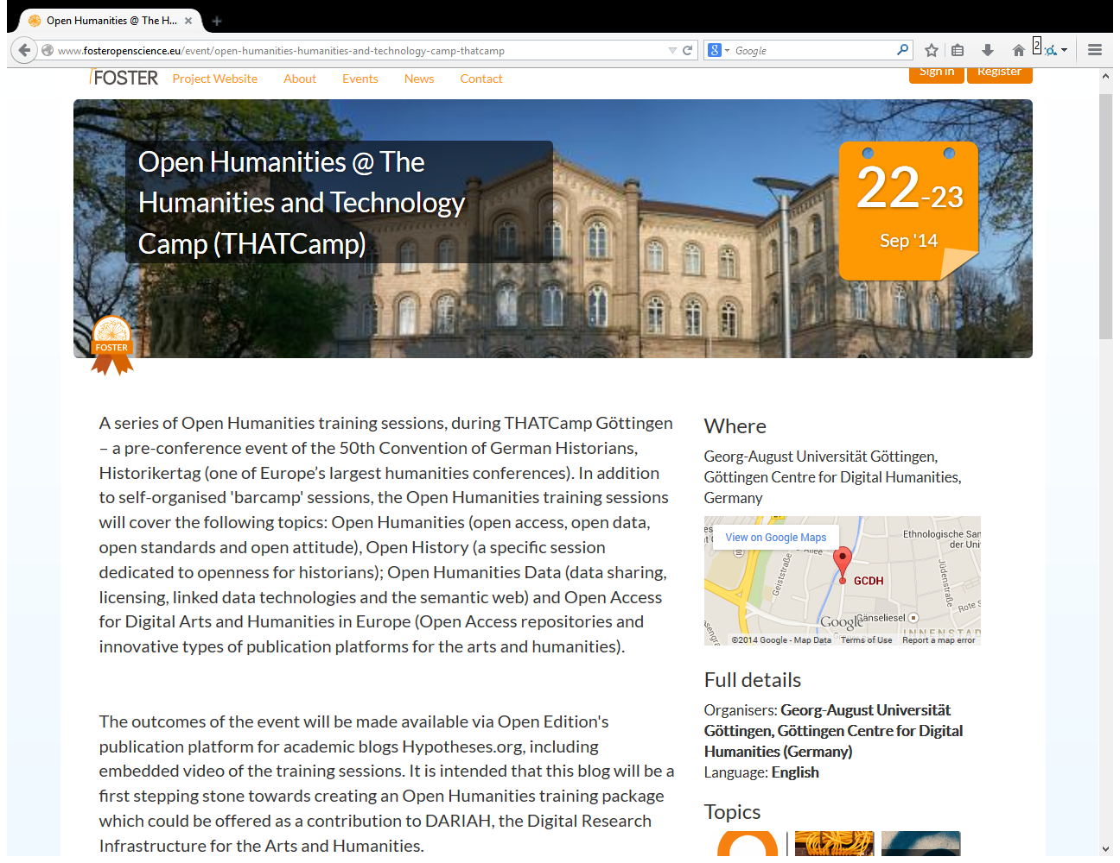
http://www.fosteropenscience.eu/

