Slide 1
The Changing Role of the University Library and Librarians from the Perspective of one American Professor
Dr. S. Lala A. Straussner,
2013 Fulbright Distinguish Chair, Masaryk University, Brno, Czech Republic
Professor and Chair, Social Work Practice Area
Director, Post-Master's Program in the Clinical
Approaches to the Addictions
Founding Editor, Journal of Social Work Practice in the Addictions
New York University Silver School of Social Work
lala.straussner@nyu.edu
UniversitiesBibliotheca Academica 2013
Association of Libraries of Czech

Slide 2
FOCUS OF PRESENTATION
The Importance of Libraries – my story
NYU and the NYU Library System
NYU Library and Students
NYU Library and Faculty
NYU Library and the Community
Acknowledgement: Lucinda Covert-Vail, MLS, MS Associate Dean & Director of Public Services, NYU Libraries
Notes:
Reluctant Bride – 2010 Comedy –reluctant speaker

Slide 3


Slide 4
My Doctoral Studies

Slide 5
The changing library picture

Slide 6
NEW YORK UNIVERSITY (NYU)
Founded in 1831, NYU is one of the largest private universities in US.
First teacher –artist/inventor Samuel F. B. Morse.
Undergraduate: 20,000 Graduate: 18,000
3,100 full-time faculty members in
18 schools and colleges at 5 centers in NYC, Abu Dhabi and Shanghai, and 13 other sites around the world (incl. Prague).
+ >50,000 students in School of Continuing and Professional Studies
Notes:
Morse – invented the telegraph, Morse code; Not University of NY in Prague.

Slide 7
The NYU Library System
NYU Division of Libraries- 7:
• Elmer Holmes BOBST Library
• Courant Institute of Mathematical Sciences Library
• Jack Brause Library at SCPS Midtown
• Library of the Institute for the Study of the Ancient World
• Stephen Chan Library of the Institute of Fine Arts
NYU Abu Dhabi Library
• NYU Shanghai Library (Fall 2013)

Slide 8
Other NYU Libraries:
• Frederick Ehrman Medical Library
• John and Bertha Waldmann Memorial Dental Library
• Law Library
Polytechnic Institute Engineering Library - 2014

Slide 9
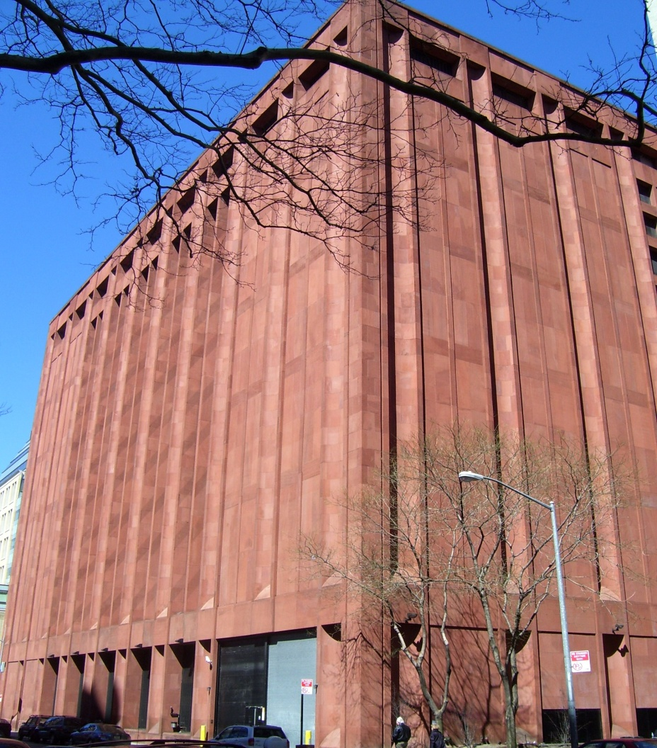
Elmer Holmes Bobst Library
Notes:
Designed by Phillip Johnson, Opened 1973. Urban, greenwich village. 12 stories above ground, plus 2 lower levels.
Highly centralized library serving most of approx 38,000 students
Phased renovation -- Johnson aesthetic -

Slide 10
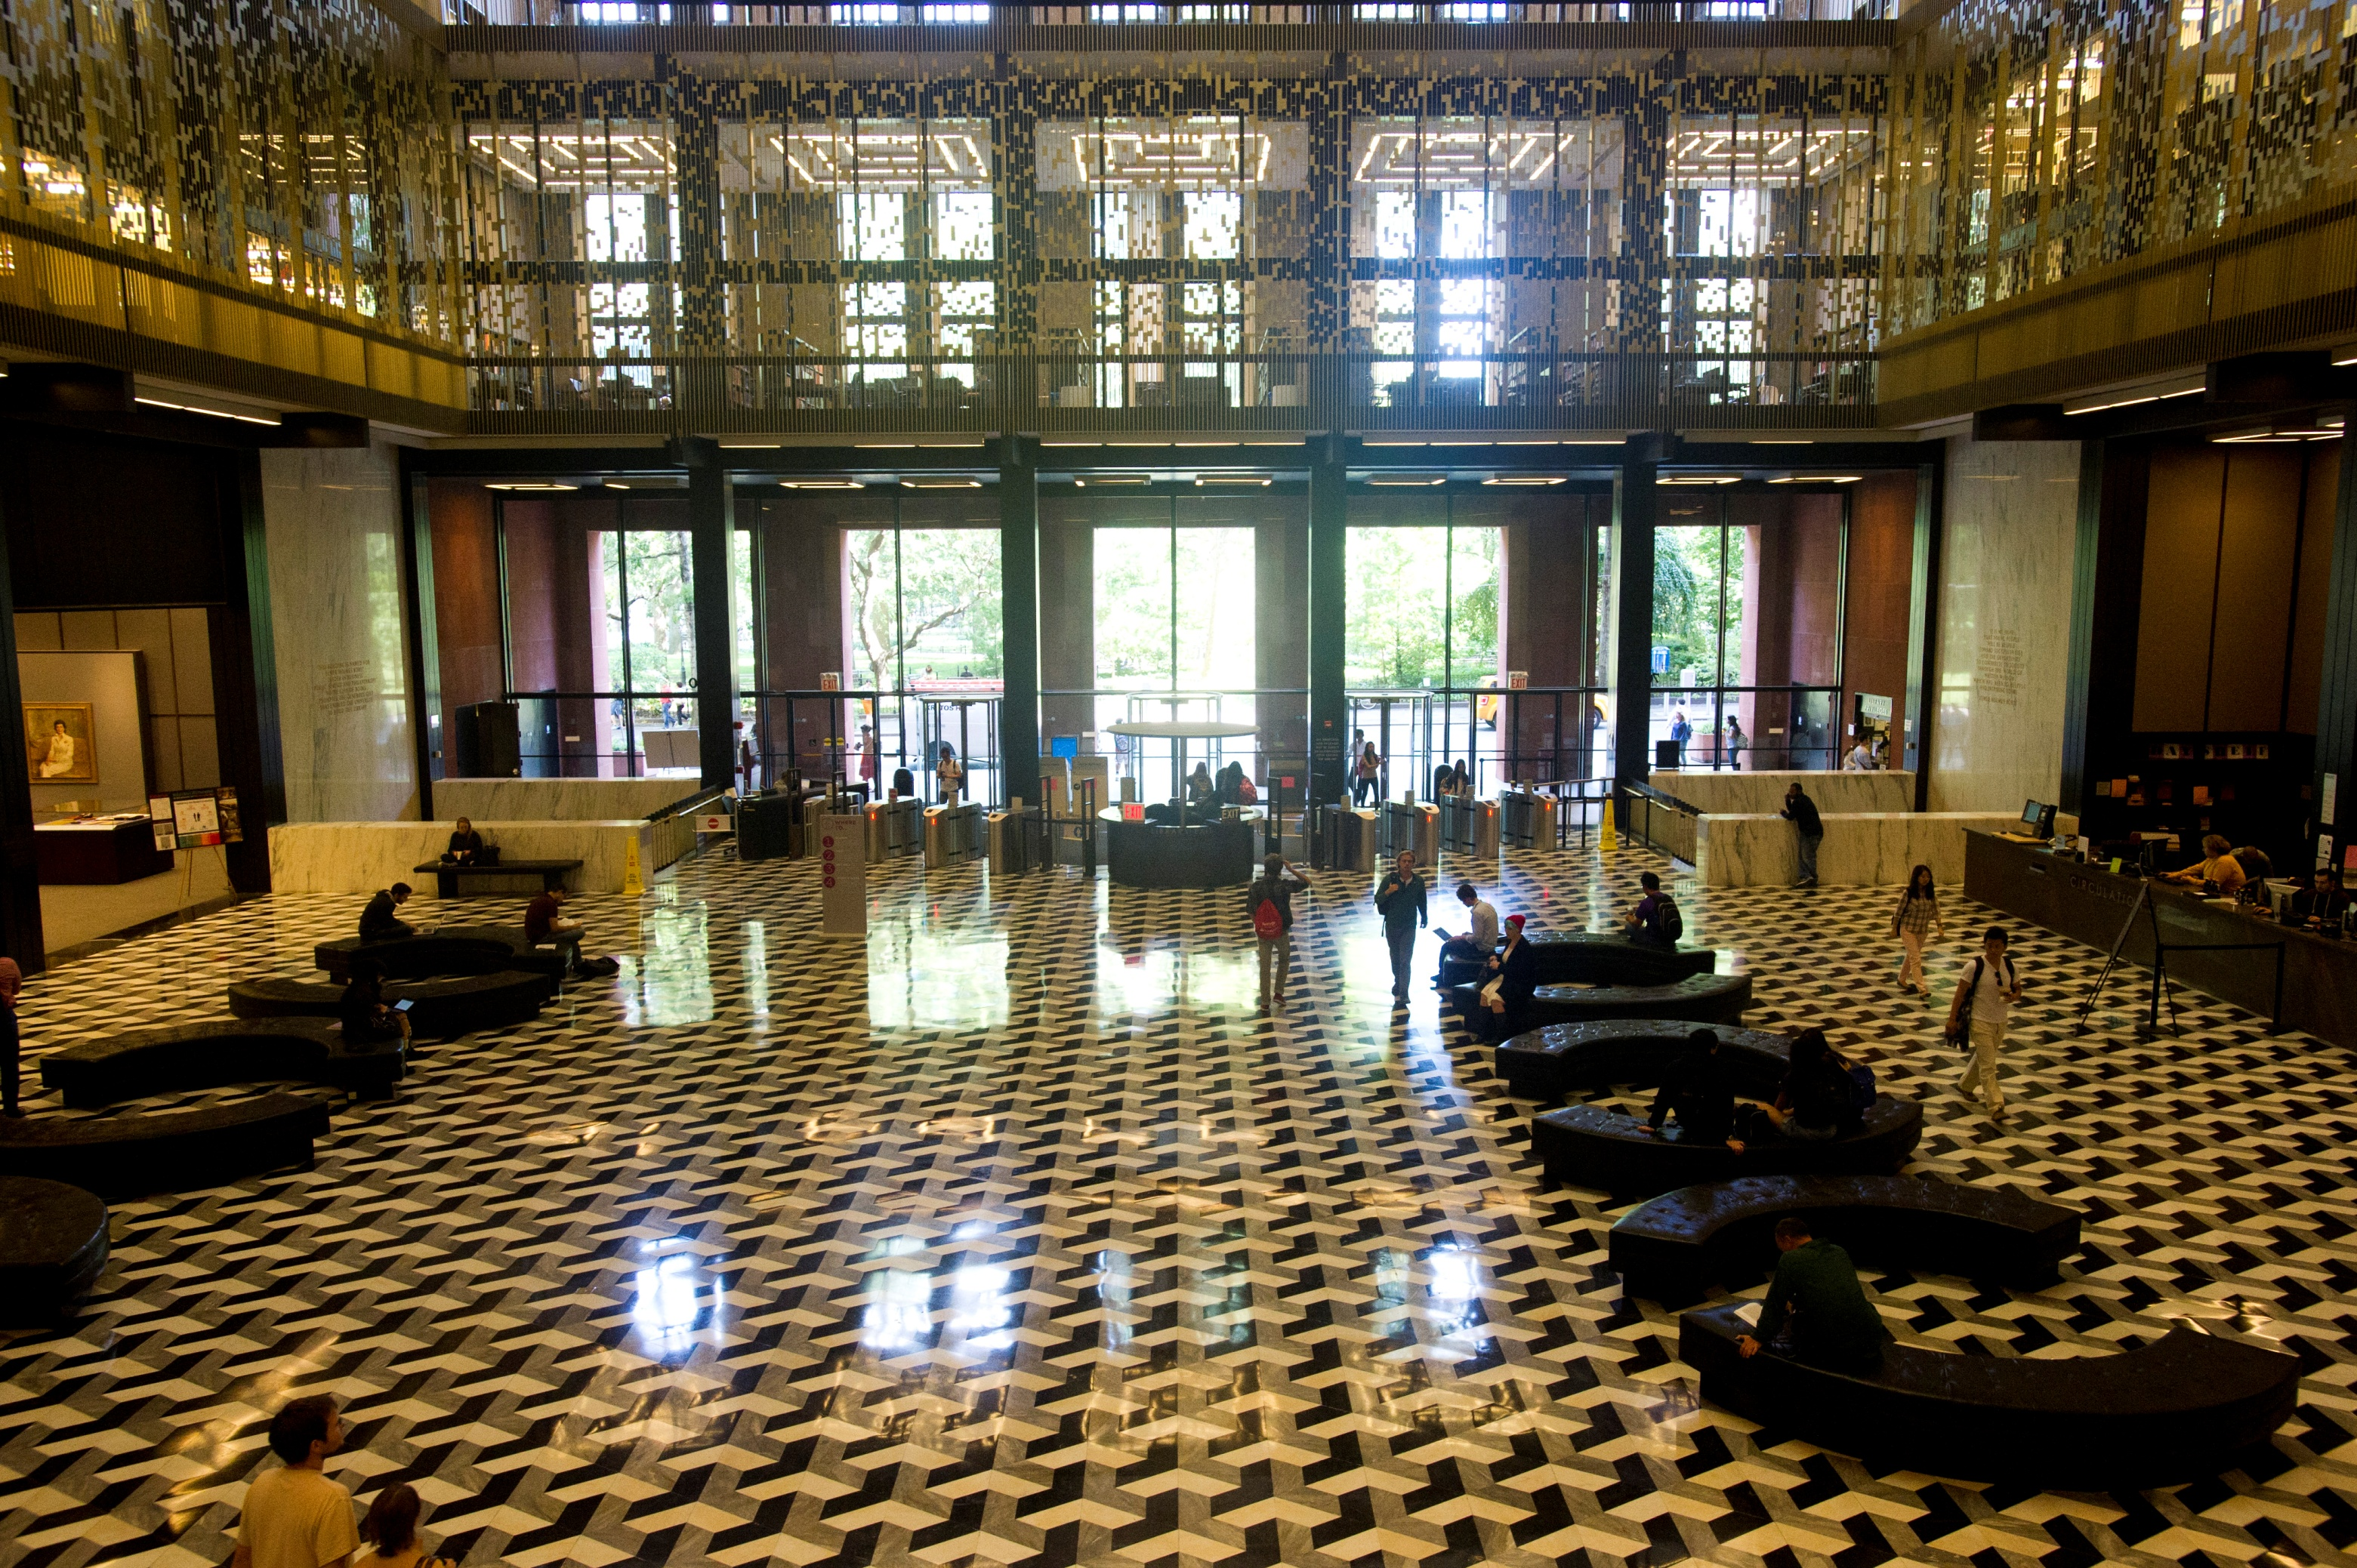
Notes:
12 STOREY ATRIUM – unforseen design

Slide 11
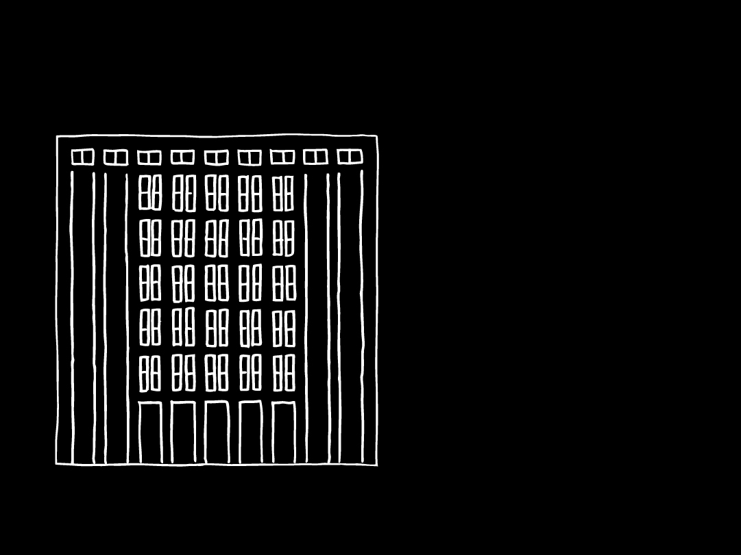
NYU Bobst Library
ADMINISTRATIIVE OFFICES
Approx 2,500 seats)
Access: 24 hrs/ day
Services: 85 hours/ week Librarians: 33 subject specialists responsible for collection development and departmental liaison + specialists in undergrad outreach, instructional services, electronic information, and digital libraries.

Slide 12
NYU LIBRARY HOLDINGS
Book Volumes: Division of Libraries: 4,494,666
All NYU Libraries: 6,297,607
Serial Subscriptions: All Libraries: 146,611
Electronic Collections: > 85,000 journal titles and e-book packages, 915 databases, and
> 900,000 e-books
Annual Visits to Bobst Library: 2,339,853 +
Guests: 869,000
E-Visits to http://library.nyu.edu 2,438,478

Slide 13
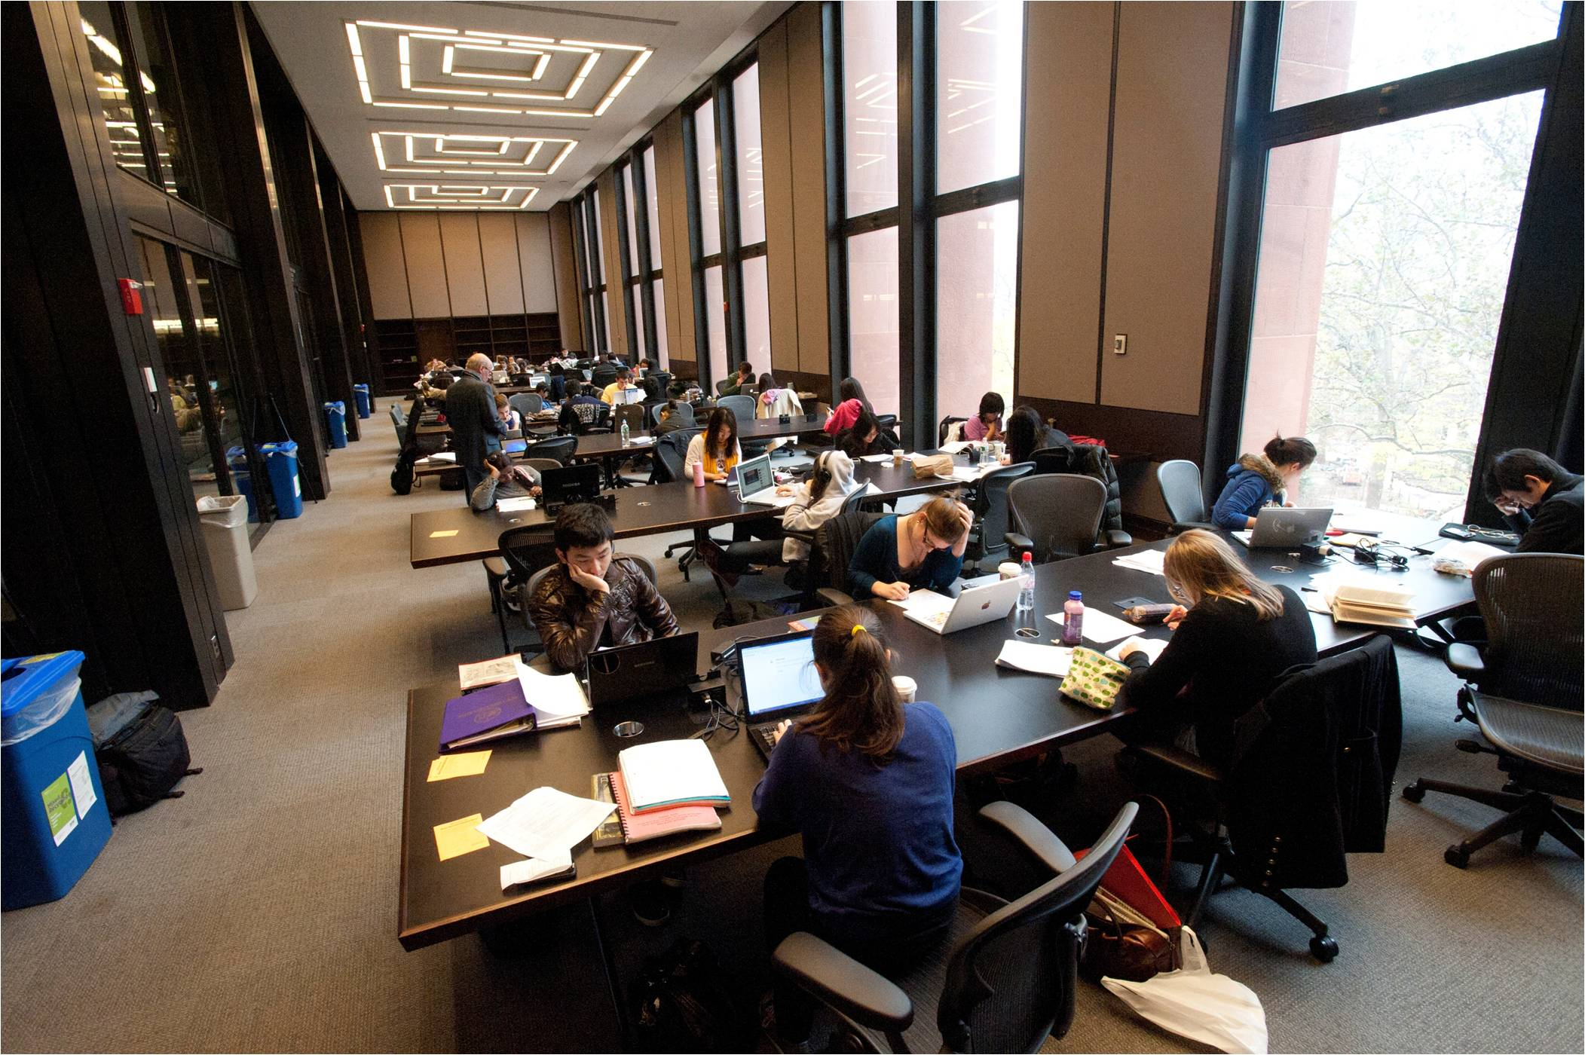
NYU Library and Students

Slide 14
SPACE AS SERVICE
Creating spaces to meet the needs of users at varying stages of education:
  High tech needs,
  Quiet study,
  Group/collaborative work
  Consultation with experts,
  Doctoral studies need

Slide 15
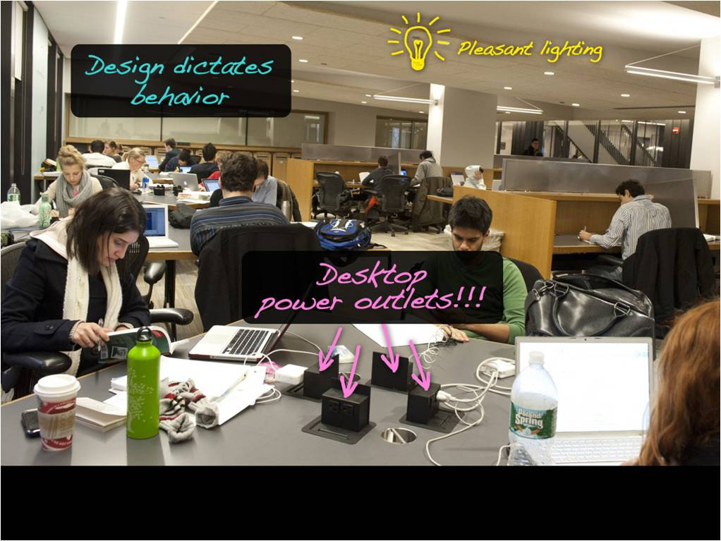

Slide 16
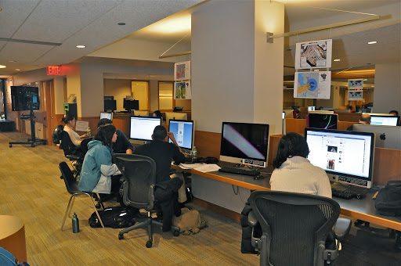
MEETING HIGH TECH NEEDS

Slide 17
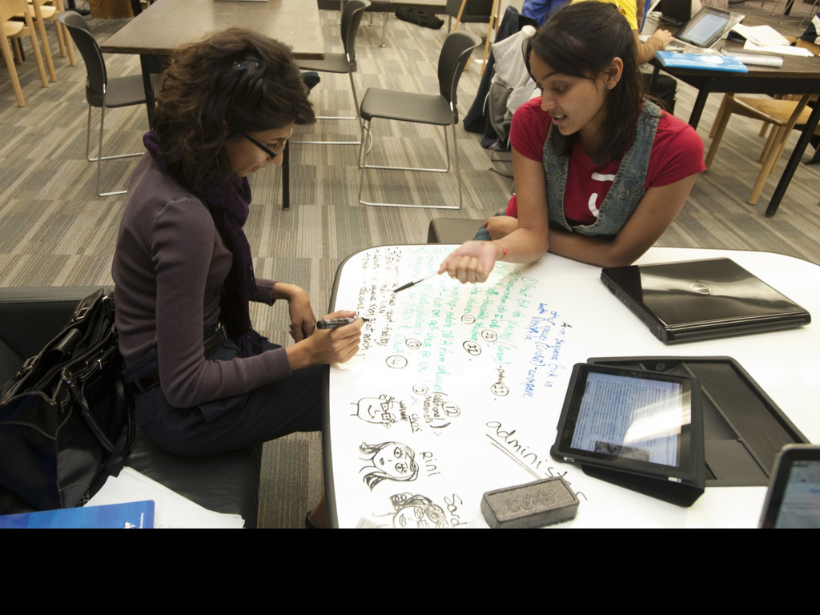
Low-tech informal group work
Notes:
Room is messy, furniture mismatched, but….white boards everywhere, even the tables -- grad only

Slide 18
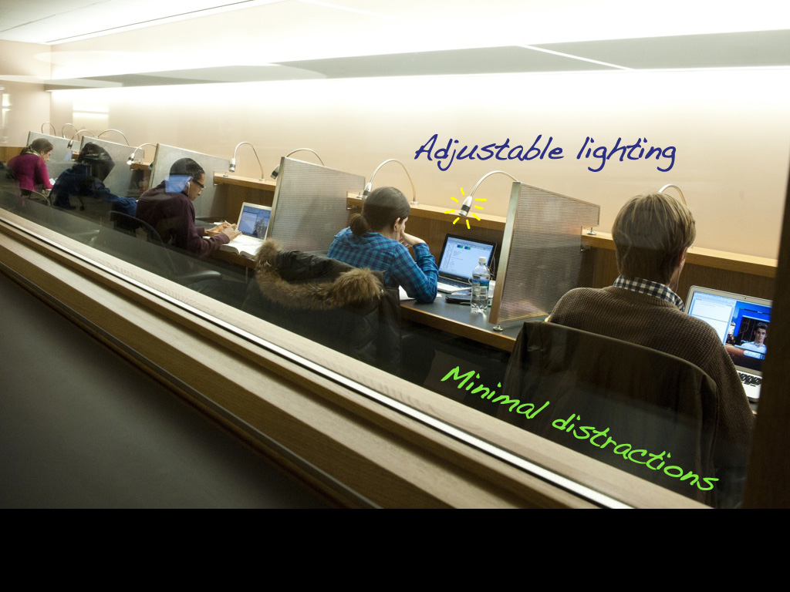
Grad-only
Secluded
Notes:
Large-footprint, individual workspace, controllable lighting, swipe control

Slide 19
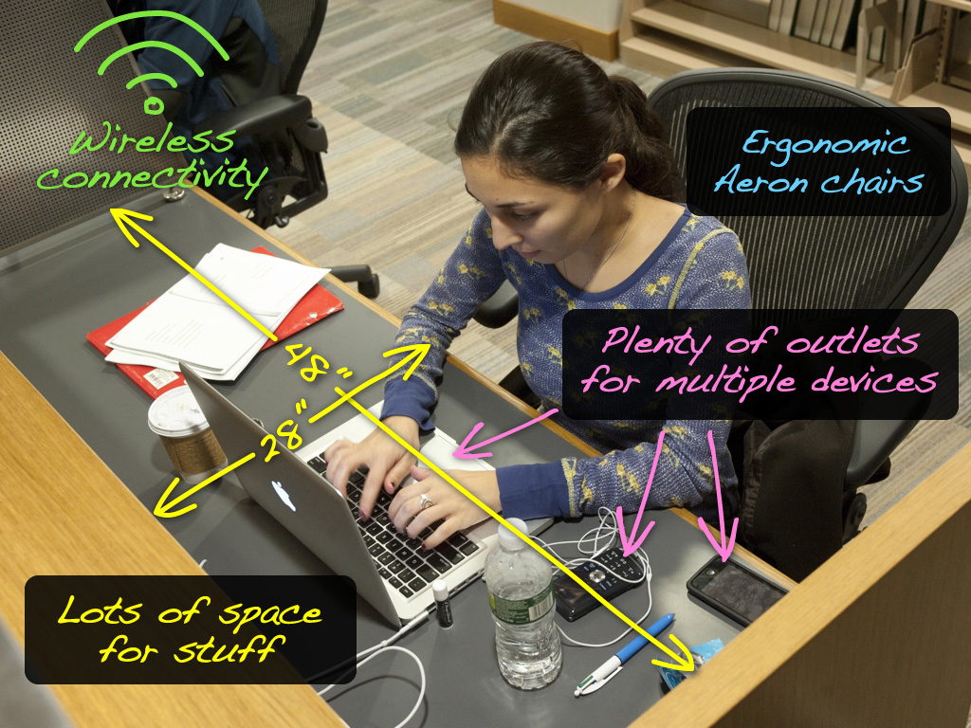
Notes:
Space for stuff
Expanded desktop

Slide 20
DOCTORAL STUDENTS
“We've moved from thinking about doctoral students…focusing solely on their research needs to…developing services, spaces and programming that cuts across the graduate student "lifecycle". In other words, not just their academic needs, but grad students as teachers, as grant seekers, researchers, writers, job seekers, etc.
This also expands to thinking about them socially and building a "community of scholars". Since their work is increasingly interdisciplinary, the library can present "cross-over" opportunities that they might not find in a strict departmental setting.”

Slide 21
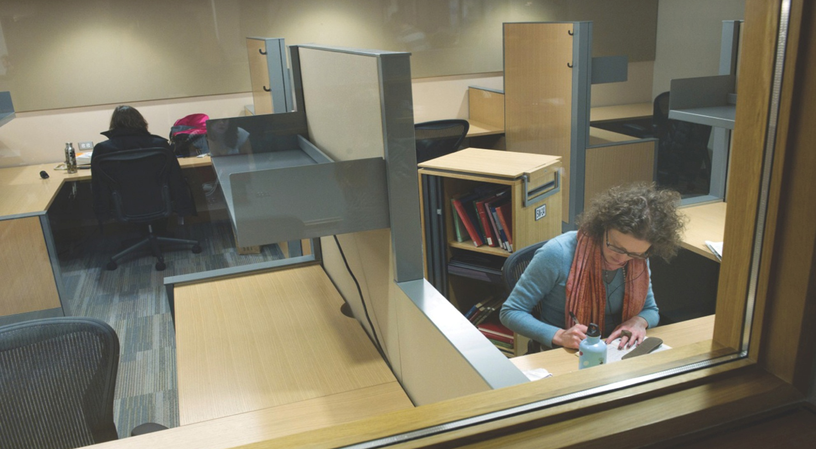
Dissertation Writers Room
Notes:
RESERVED SPACE WITH mobile storage –MOBY
Hoped to create Community of scholars. In this and last space – windows….not daylight

Slide 22
Library Services for Faculty
TRADITIONAL SERVICES-PAST:
  Help from Subject Librarian- support faculty in building literature collections to enrich curriculum
  Borrowing, Interlibrary Loan Reserve readings/e-reserve
  Audio/Video Showing/Loans Library instruction classes
  Etc,

Slide 23
PRESENT
Classroom and Teaching Support – linking Library Services with Information Technology Services (ITS)
Linking to e-journals, media and other
library content in NYUClasses
(The NYUClasses online learning system
enables faculty to use the Web to enhance
classroom instruction- formerly, Blackboard).

Slide 24
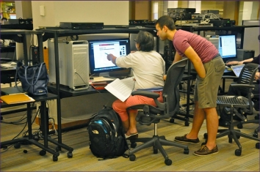
Digital Studio
Because of wired classrooms- no need to use A/V space in the library – link to U-tube
Digital Studio

Slide 25
The Digital Studio –Supports Faculty Scholarship, Research and Teaching
Provide consultation, training, and tools for:
Multimedia capture, production, and publication (audio, video, images, various editing and delivery tools and platforms)
Digital scholarship, digital project planning, and management
Copyright and fair use (including creative commons licensing, open access, and author's rights)
Digital Publishing: NYU Wikis,
Faculty Digital Archiving and Management- storing and sharing digital works—text, audio, video & data,

Slide 26
NYU Library and Faculty:
Future
Research support for faculty re: new forms of scholarly communication
including online scholarship (e.g.
MOOC – Massive Open On-Line Courses)
Institutional Repositories- Cloud-based
platforms, Faculty Digital Archive
Copyright/permissions support –BOTH
in terms of faculty’s own intellectual
  property, and use of data and scholarship of others- Open Access (Green vs. Gold).
  Ongoing training, such as:

Slide 27
Learn How to Navigate the OECD iLibrary
Thursday, October 31, 2013 @ 5:00 pm
NYU Bobst Library, Room 619 Register: http://is.gd/NYUOECD
Learn how to navigate the OECD (Organization for Economic Cooperation and Development) iLibrary with Kathleen Deboer, Deputy Head of the Washington Center for the OECD.
In this workshop you will discover how to access the wide variety of reports and statistics offered by this international organization in fields like economics, education, and health care.
Learn how to browse content by country and/or theme and how to create your own customizable cross-country time series data.

Slide 28
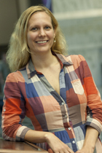
THE NEW LIBRARIAN
Faculty Librarians become "hybrid", having not only a subject specialty, but perhaps
legal or digital or instructional design expertise.
Melissa A. Brown, JD, MLIS
Bobst Library, IM-07
212.992.7311
melissa@nyu.edu
Subjects:
Copyrights, Scholarly Communication

Slide 29
NYU Library and the Community
An Invitation From:
The NYU Fales Library; Steinhardt School of Culture, Education and Human Development, Dept. of Nutrition, Food Studies & Public Health;
24/7 Food: The New Role of Food in American Life
Panelists: Matthew Derr, Kim Hastreiter, Marion Nestle, Allen Salkin Moderator: Clark Wolf
Thur, Oct 10, 2013 4:00 - 6:00 pm Bobst Library, 3rd fl
Please RSVP with your name/date of event to: rsvp.bobst@nyu.edu
Notes:
Brings me to the last part – libraries moving beyond serving students and faculty,
Beyond books -

Slide 30

BACK IN THE LIBRARY
Notes:
Not to read or take out a book – but to learn something new.
Thank you for helping me do that.

Slide 31
Recommended readings by Lucinda Covert-Vail. Director of Public Services, NYU Libraries
Covert-Vail, L & Collard, S. (2012) Research Library Services for Graduate Students (PDF), http://www.arl.org/news/arl-news/169-arl-publishes-new-roles-for-new-times-research-library-services-for-graduate-students
Ithaka US Faculty Survey targets the faculty/library space: http://www.sr.ithaka.org/research-publications/us-faculty-survey-2012
Ithaka. UK survey of Academics
http://www.sr.ithaka.org/research-publications/ithaka-sr-jisc-rluk-uk-survey-academics-2012
Ithaka. Supporting the changing research practices of historians
http://www.sr.ithaka.org/research-publications/supporting-changing-research-practices-historians
Jaguszewski, JM & Williams, K (2013). Transforming Liaison roles in Research Libraries. http://www.arl.org/news/arl-news/2896-new-roles-for-new-times-arl-publishes-report-on-transforming-liaison-roles-in-research-libraries
Rentfrow, D. No Brief Candle: Reconceiving Research Libraries for the 21st Century, http://www.clir.org/pubs/reports/pub142
http://www.arl.org/storage/documents/publications/NRNT-Liaison-Roles-final.pdf

